Slide 1
CS2311 – Lab 1
Getting Started with Visual Studio 2012
Fall 2018

Slide 2
Outline
Introduction and installation of Visual studio (VS)
Writing, compiling, and executing C++ programs using VS

Slide 3
Working Environment
In this course, you will be working with PC under Windows 7, and all the programs will be written with Visual Studio 2012.
In this lab, you will explore and get familiar with the MS Visual Studio 2012 compiler working environment.
Visual Studio 2012 is an integrated developing environment (IDE). Inside the Visual Studio 2012 compiler, you can edit, compile, link, run, debug and manage your programming projects.

Slide 4
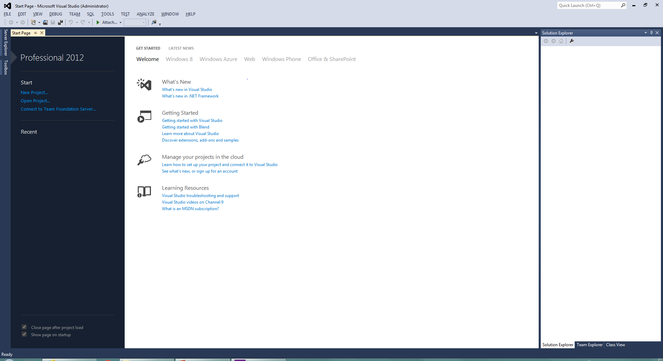
Setting up Visual Studio Environment (In CSC Labs)
Locate Microsoft Visual Studio 2012 from the Start icon on Desktop.
Visual Studio 2012 and Visual Studio 2015 are similar IDEs and both of them can be used in this course.

Slide 5

How to start VS2012 in CSC labs
Double click the “Work Desk” icon on the desk

Slide 6
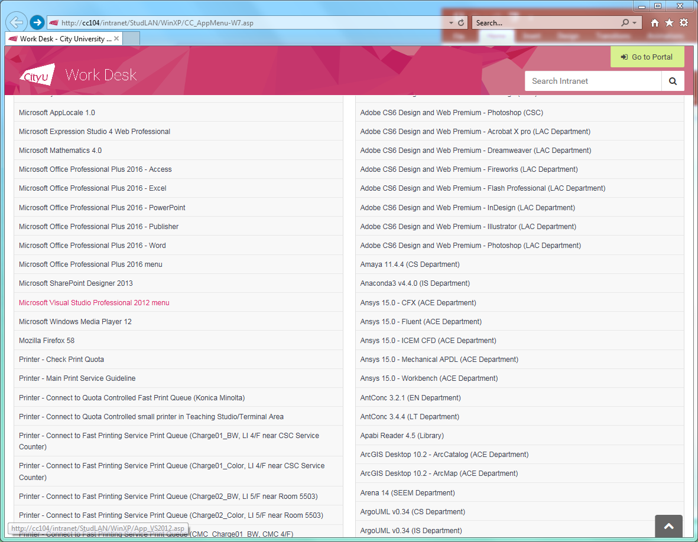
How to start VS2012 in CSC labs
Click “Microsoft Visual Studio Professional 2012 Menu” in the “Central Software” list on the left.
Click this

Slide 7
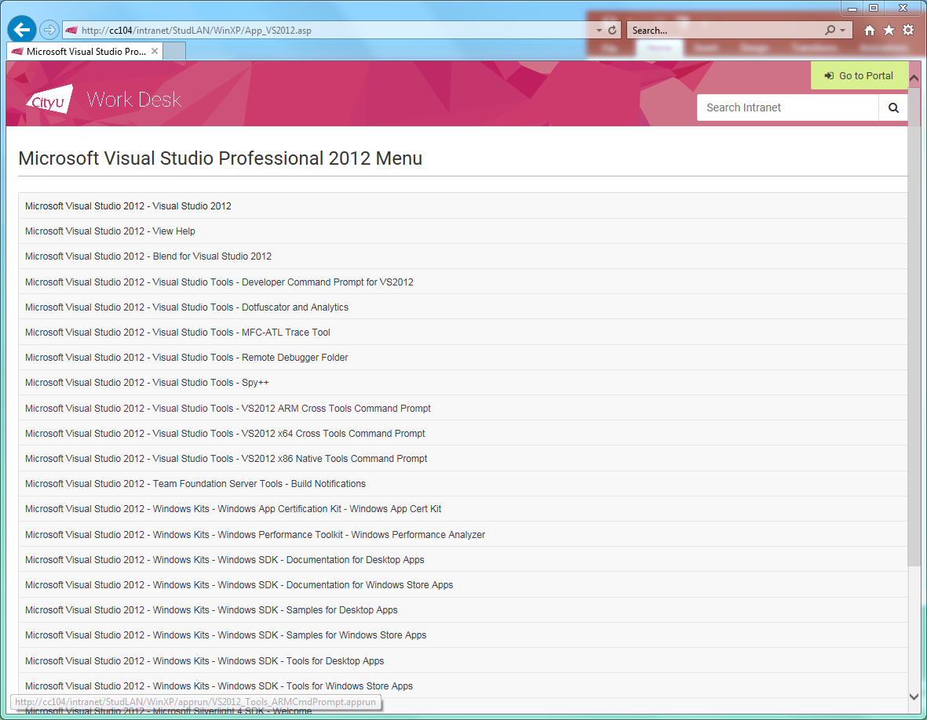
How to start VS2012 in CSC labs
Click “Microsoft Visual Studio 2012-Visual Studio 2012”
Click this

Slide 8
Outline
Introduction and installation of Visual studio (VS)
Writing, compiling, and executing C++ programs using VS

Slide 9
Steps for writing, compiling and running c programs
Create a project and project folder
Create a folder for storing programs (source code)
Add the source code to project
Compile and run the program

Slide 10
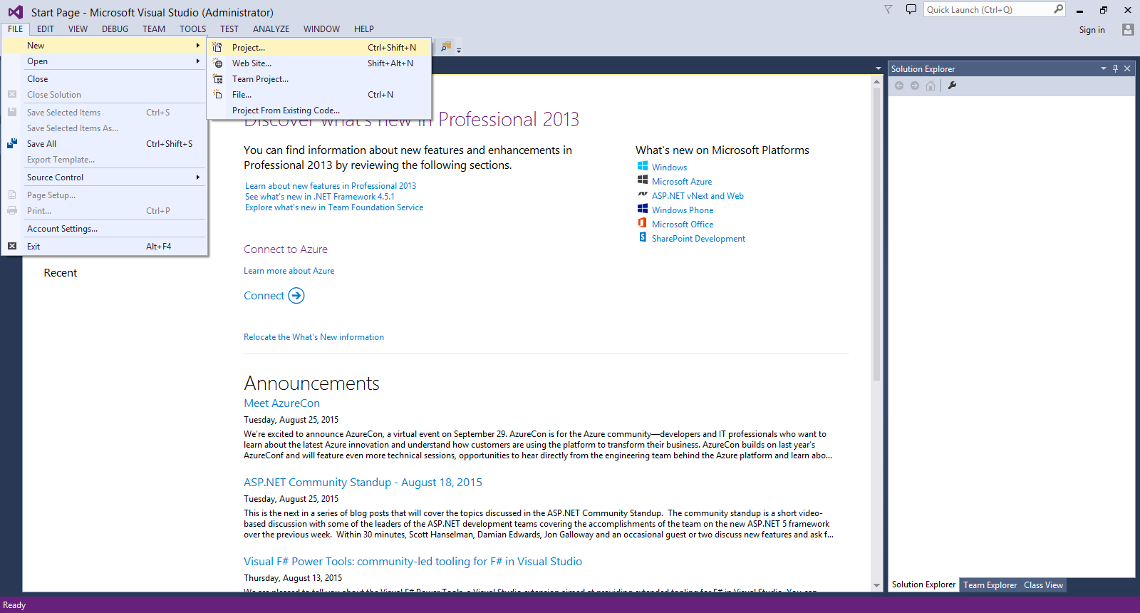
Create the project
Select File
Mouse over New
Click Project…

Slide 11
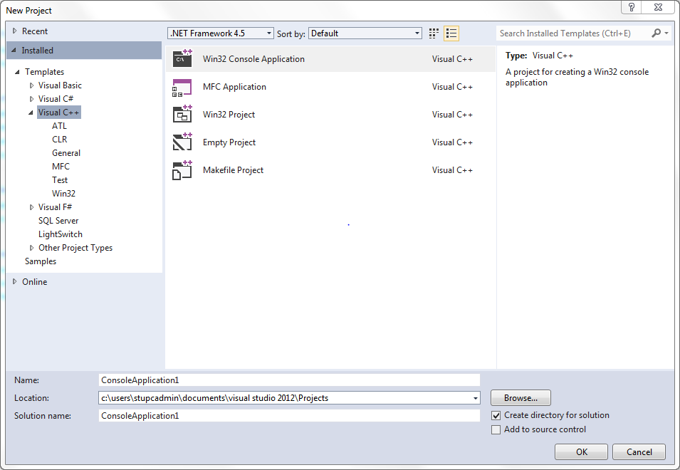
Create a C++ Console Project
2: Select Win32 Console Application
1: Select Visual C++
3: Select the folder where you want the project saved
e.g. c:\users\<your log in name>\documents\
visual studio 2012\Projects
4: type a folder name, e.g. tut1
5: uncheck “Create directory for solution”
6: click OK

Slide 12
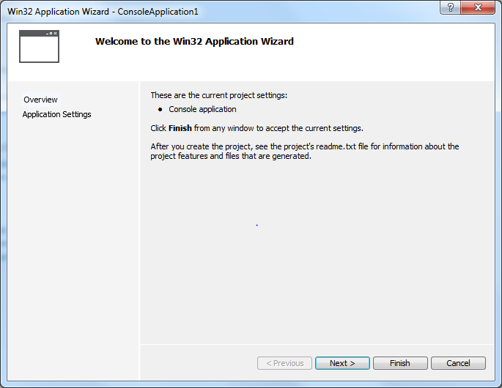
Customize the project setting
click Application Settings

Slide 13
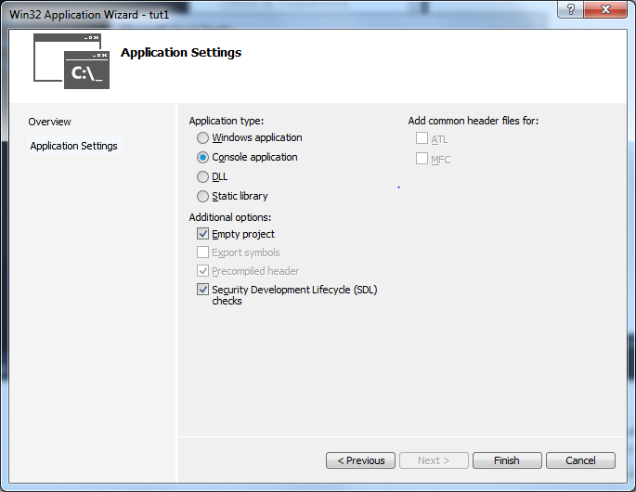
Customize the project setting
1: check Empty project
3: click Finish

Slide 14
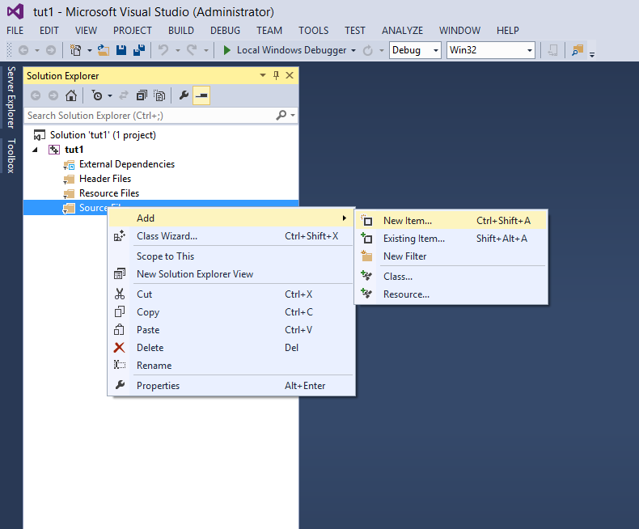
Add a C++ program file into the project
1. Right click Source Files
2. Mouse over Add
3. Click New Item…

Slide 15
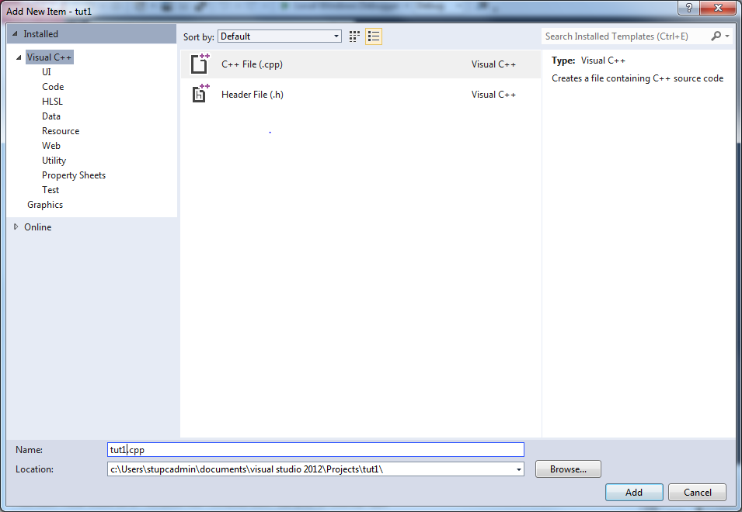
Add a C++ program file into the project
1: select C++ File(.cpp)
3: click Add
2: enter a file name, e.g. tut1

Slide 16
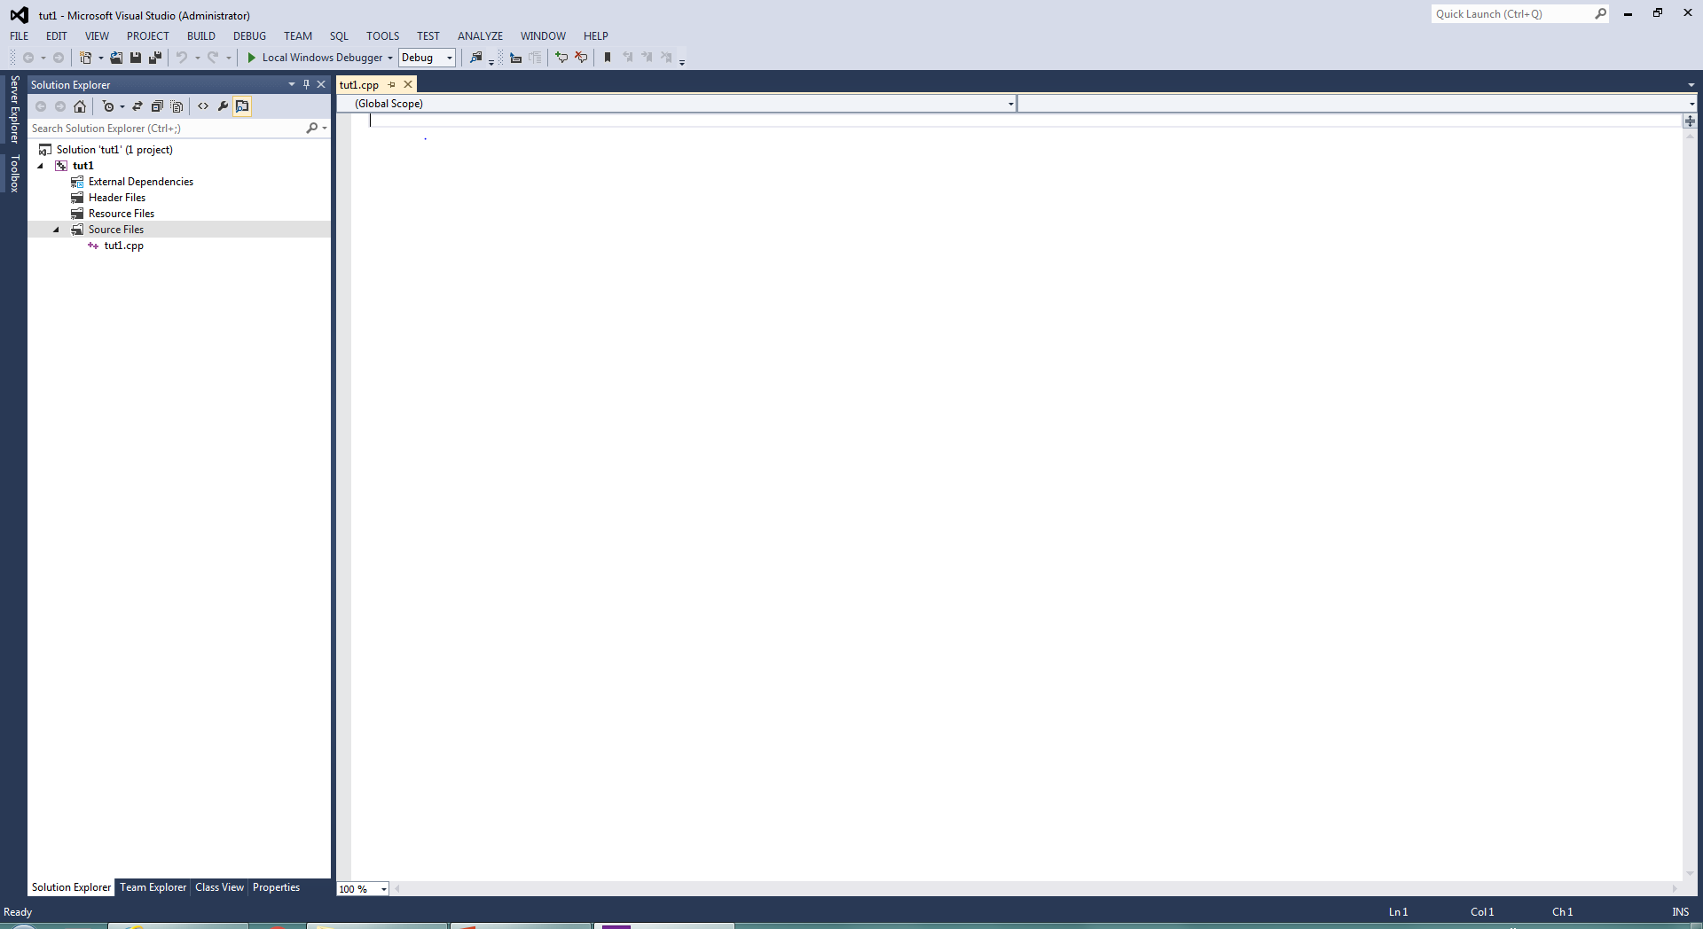
Writing code
The area for typing project code
The cpp file just created

Slide 17
Writing code
Try to type the Hello World program, without looking at the lecture notes

Slide 18
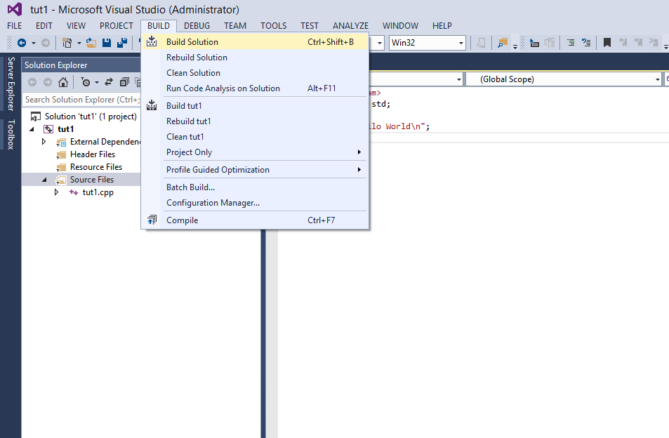
Build (Compile) your program [Ctrl+Shift+B]
click Build Solution

Slide 19
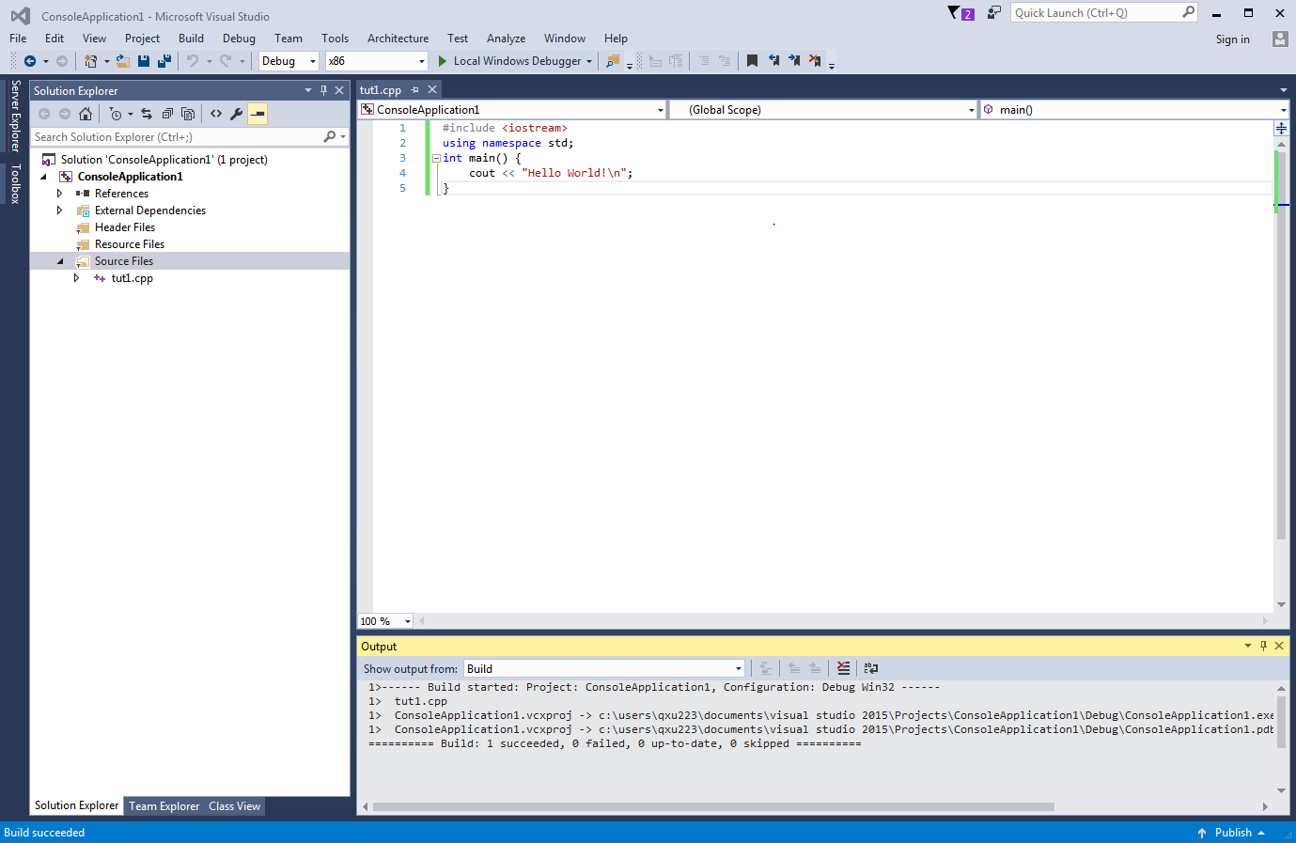
Build your program
If the program can be built successfully, you will see 1 succeeded here

Slide 20
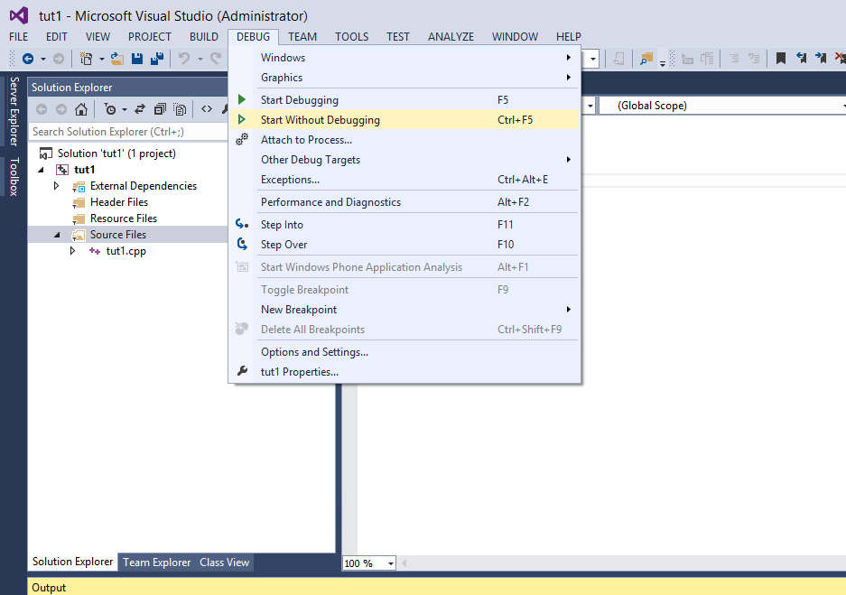
Execute your program [Ctrl+F5]
click Start without Debugging…

Slide 21
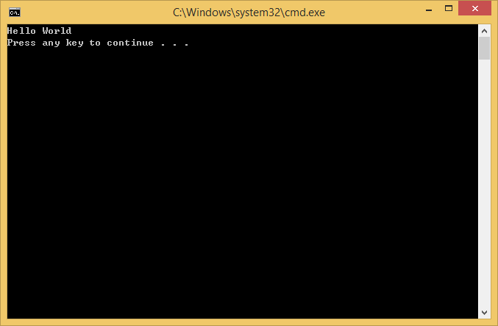
Result of Execution

Slide 22
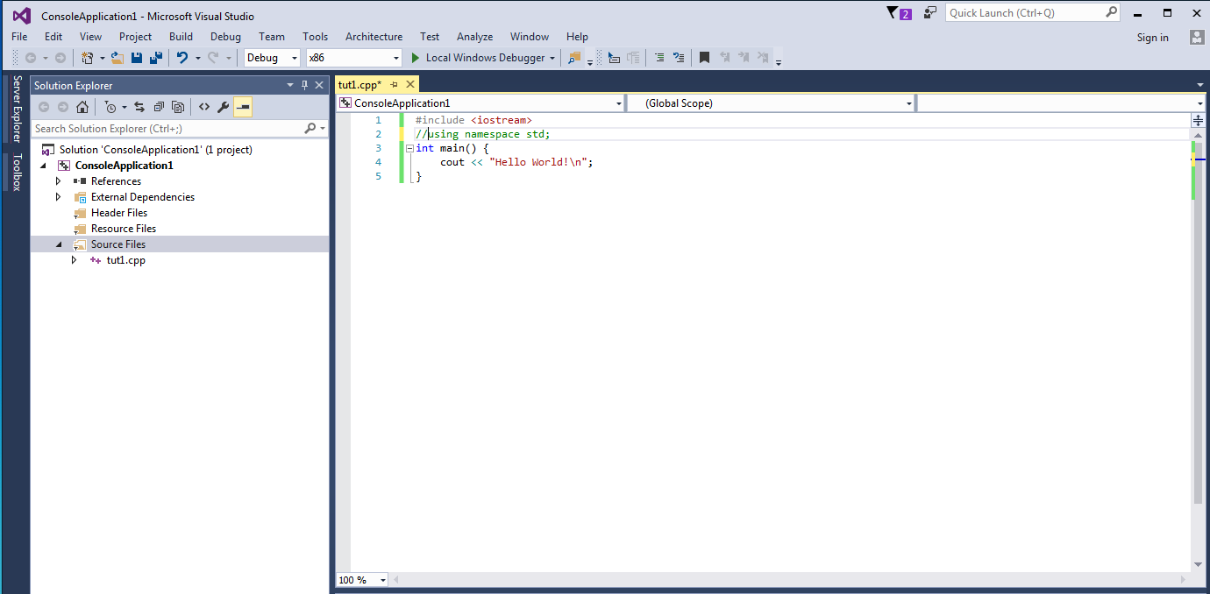
Try it out!
Comment this line

Slide 23
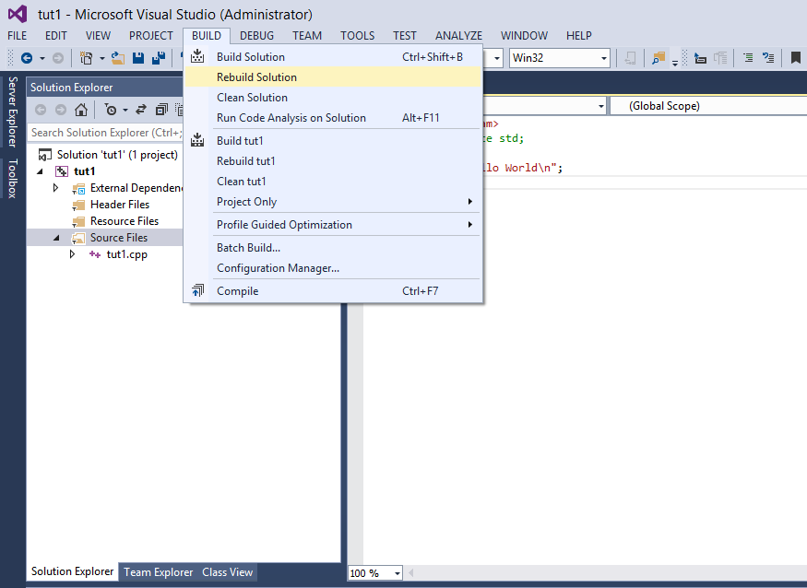
Rebuild the project
This time, click Rebuild Solution because the project has been built before

Slide 24
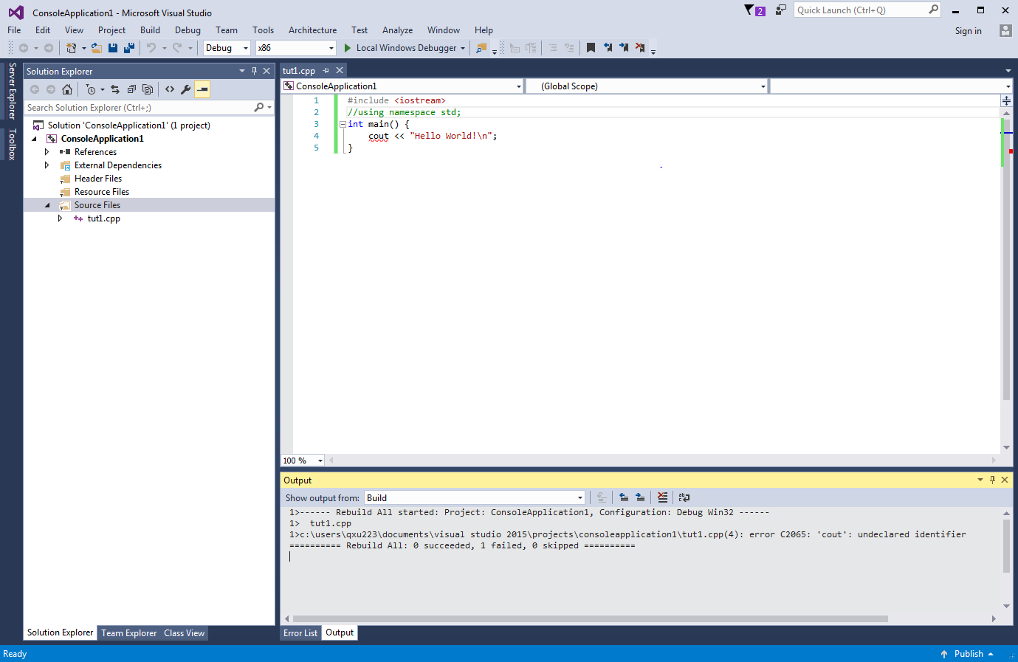
Got an error message
0 succeeded, 1 failed The program has some problem! No executable is made

Slide 25
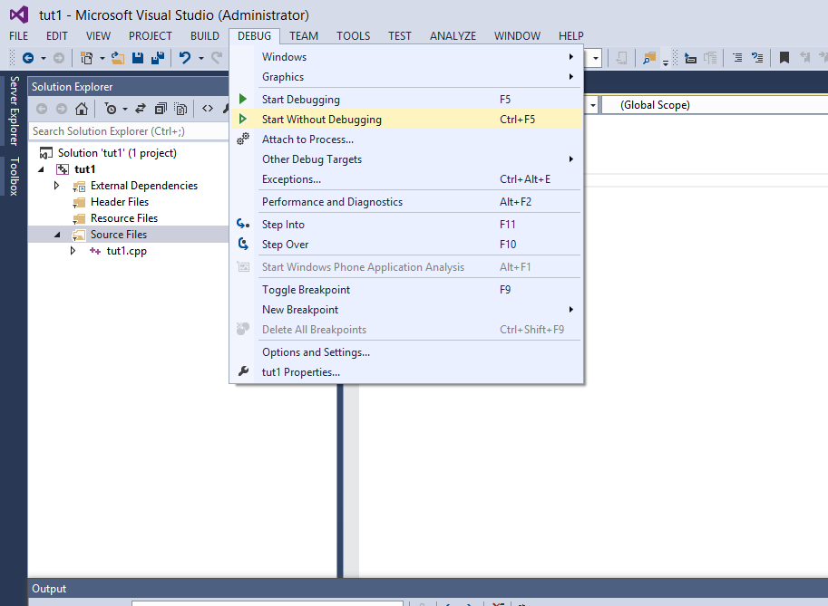
If you try to execute it anyway..

Slide 26
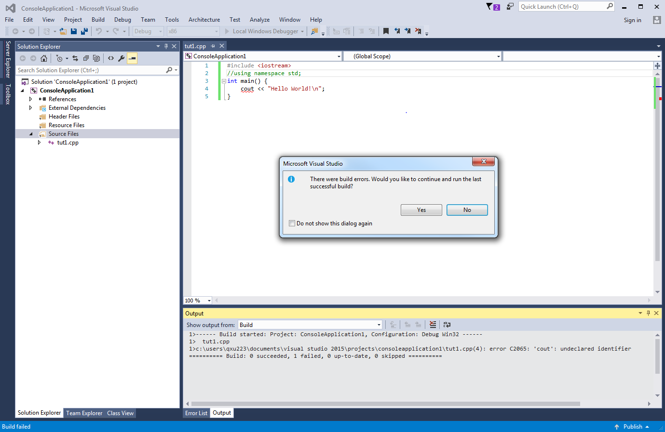
You will get an error message

Slide 27
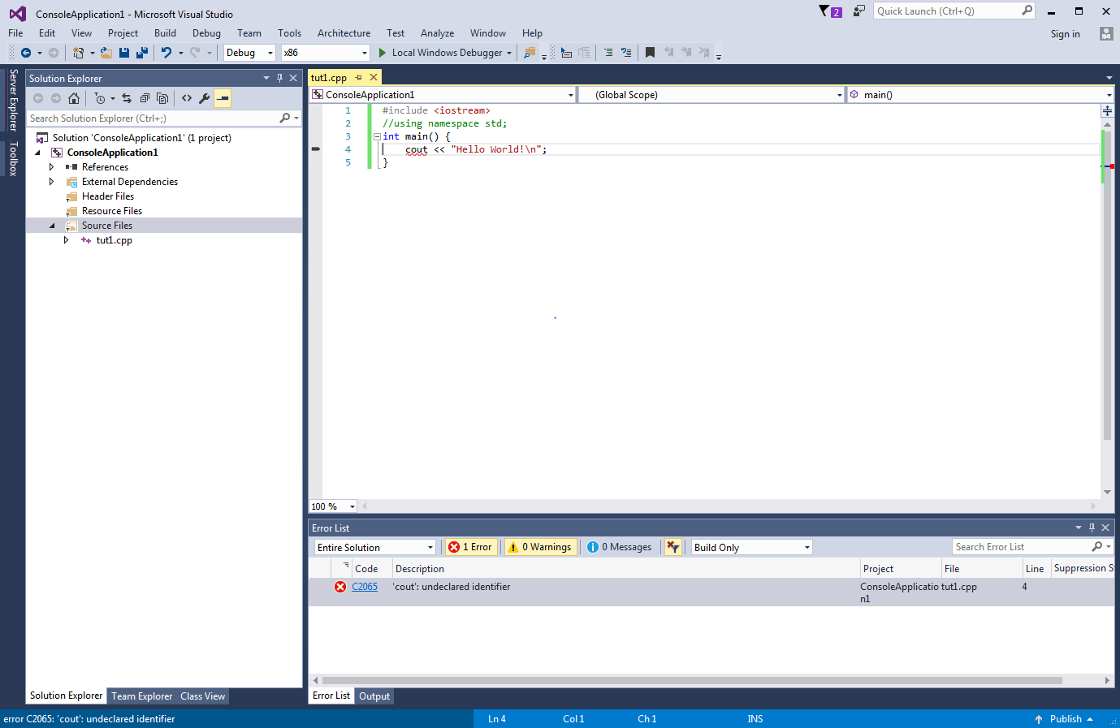
A better way: Locate the error
A maker will be placed beside the line that makes program failed to build
Double click the error message

Slide 28
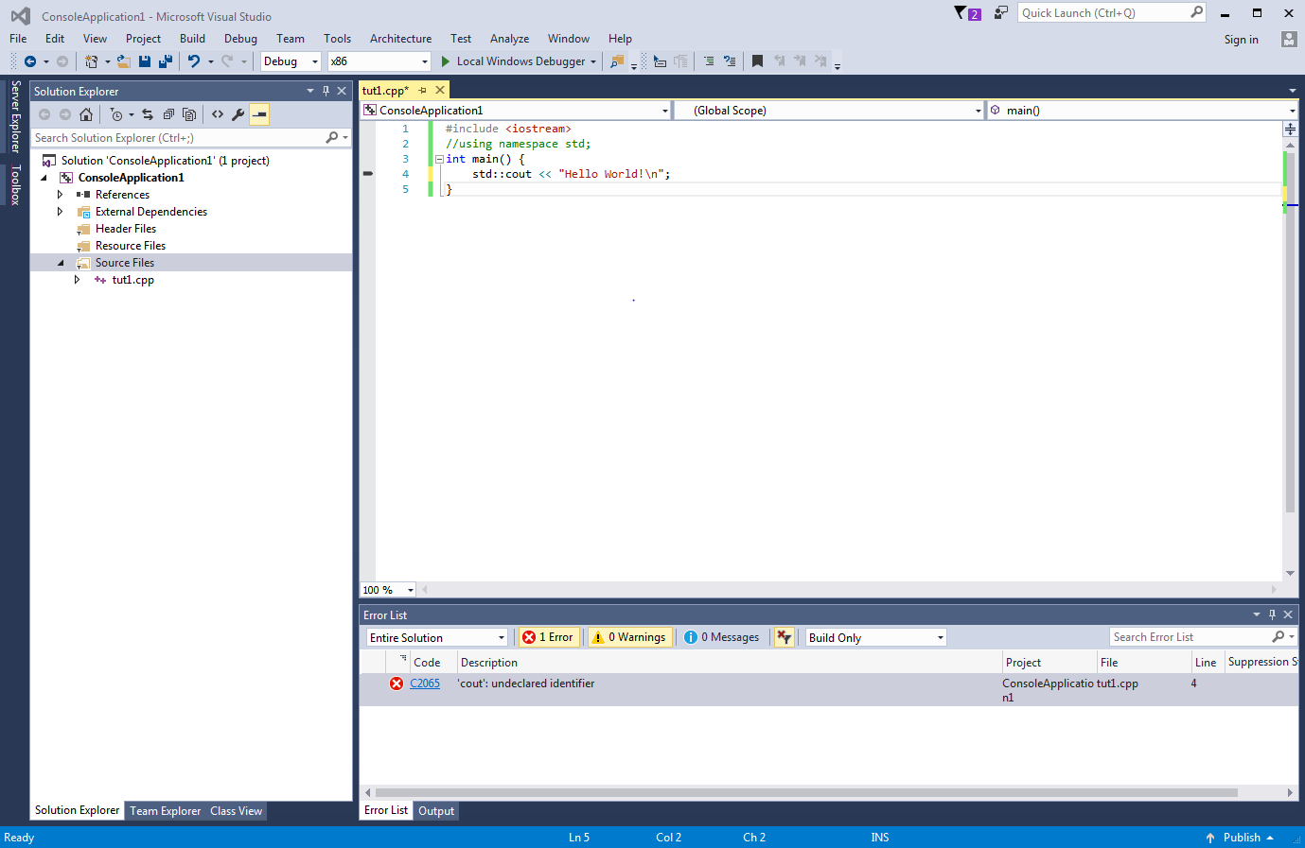
Fixed the error
Add std:: before cout, it tells the compiler the cout object is defined in std namespace

Slide 29
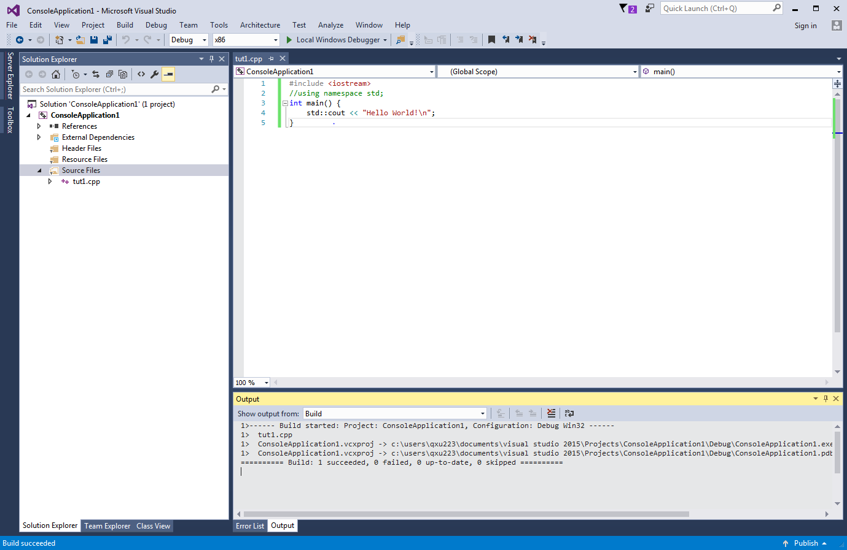
Rebuild the project: Fixed!
It is success this time!

Slide 30
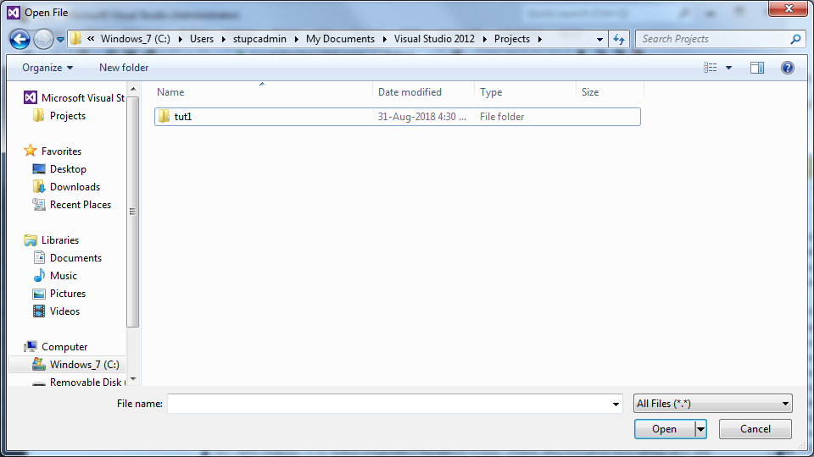
Copy your project out
Locate your project (the path may be different if you choice different path in project creation
Copy the whole folder into your USB or elsewhere

Slide 31
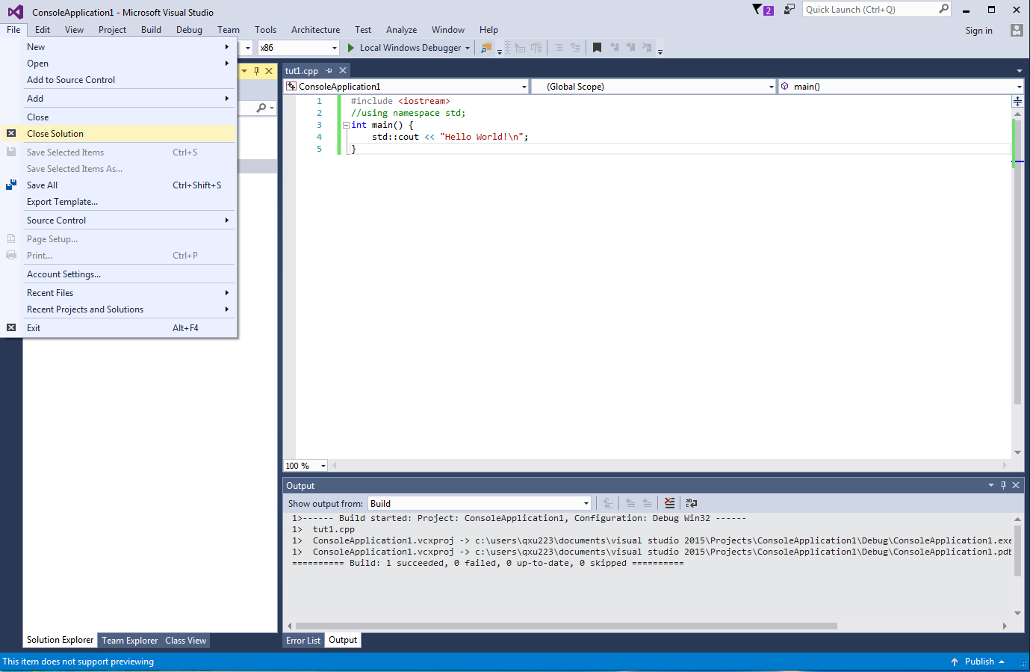
Reload your project
Close it first!

Slide 32
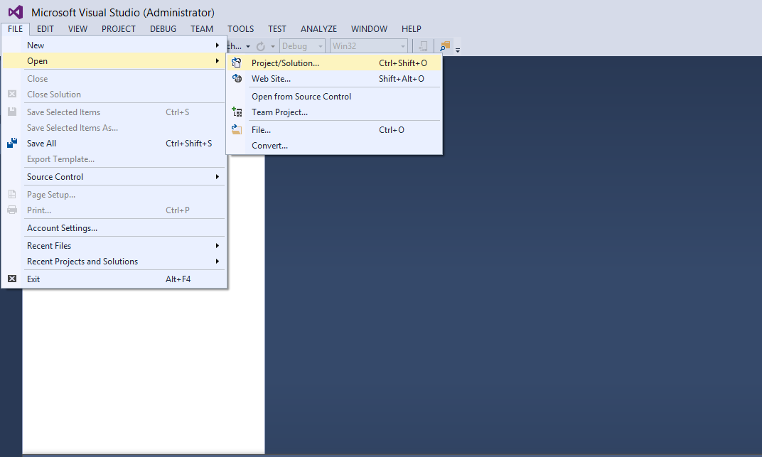
VS without project loaded
Click File >> Open>>Project/Solution

Slide 33
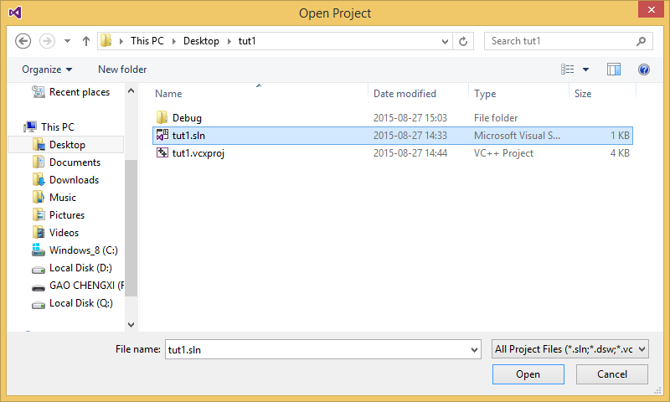
Locate and select your project
1. Select tut1.sln from the project folder you copy before
Click Open

Slide 34
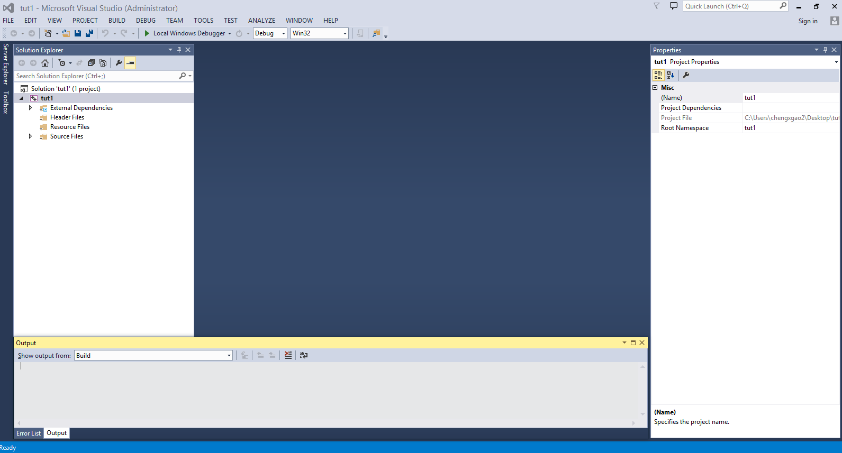
Your project is loaded

Slide 35
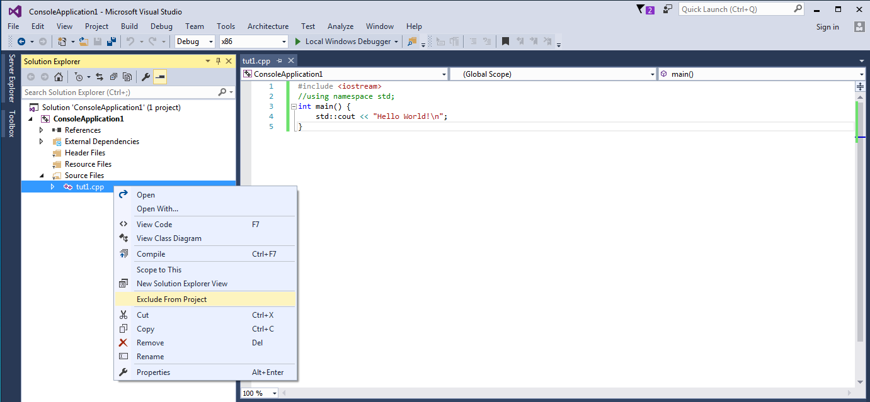
Work on other program with the same project
Within the same project, we can only have one “main” function. If you want to add another program file with function main, exclude the existing one first!

Slide 36
What you have done in this Tutorial
Create a Visual Studio 2012 Project
Create and add a C++ program into the project
Write a simple Hello World Program
Build and Execute the program
Locate the syntax error of a program

Slide 37
Downloading a Visual C++ 2015 compilers (try it yourself at home)
Visual Studio 2015can be found at: http://msdnaa.cs.cityu.edu.hk/
Login using “CITYUMD\your_EID”.
Select Visual Studio Enterprise 2015 Edition
Add the following items to the shopping cart
VS2015 (With Update 3)
Download and run the executable files.
Burn the iso files to DVDs (or using software to mount the DVD image).
Click setup to install.
Note: Since Visual Studio 2012 is no longer available in MSDAA, we recommend you to use Visual Studio 2015 instead. VS2015 has almost same IDE as VS2012.

Slide 38
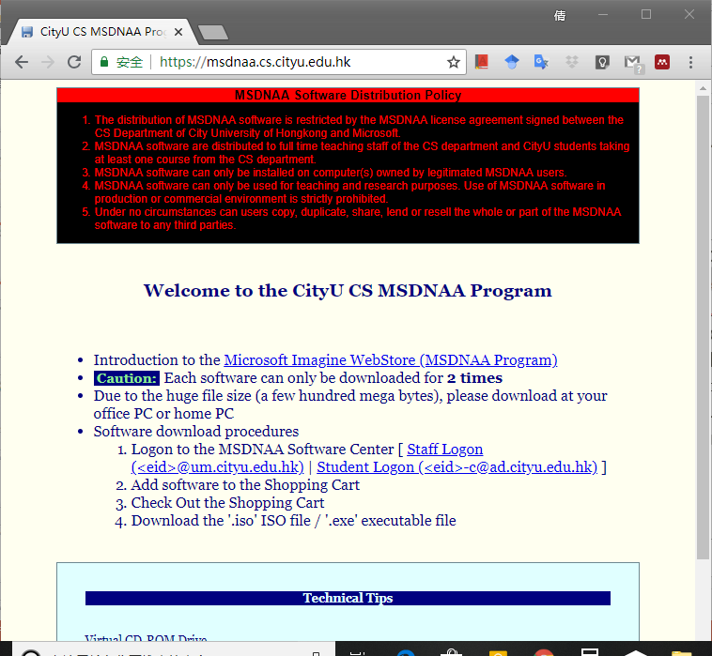
Enter the MSDNAA Software Center
Click this

Slide 39
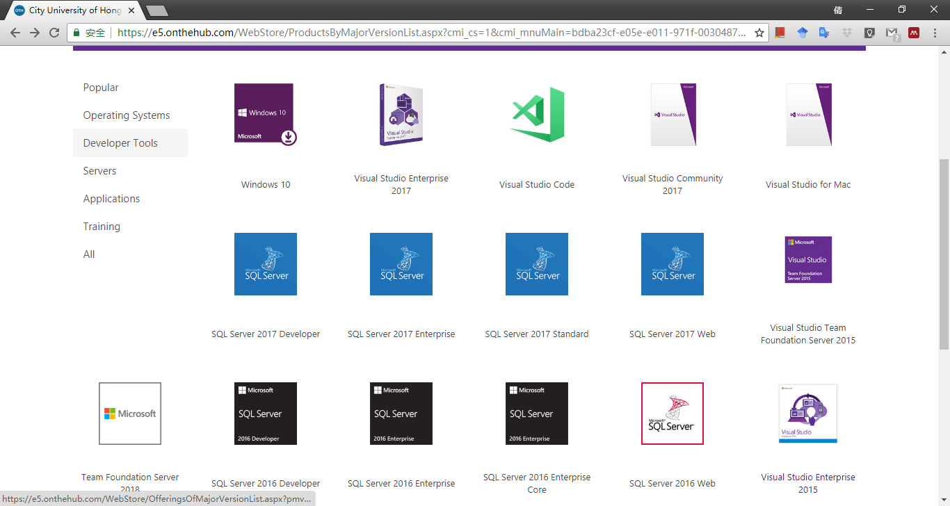
Select Visual Studio Enterprise 2015
1. Select Developer Tools
Select Visual Studio Enterprise 2015

Slide 40
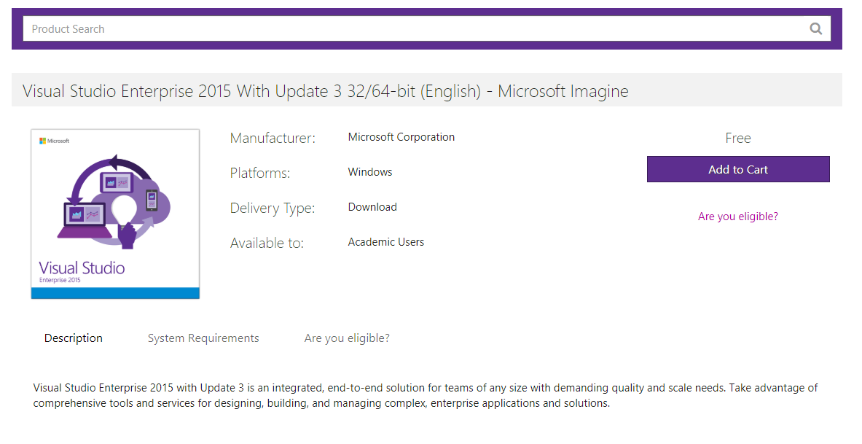
Add VS2015 (With Update 3) to shopping cart
Click Add to Cart and then check-out

Slide 41
For Mac or Linux users
You can use CLion in Mac or Linux, which is A Cross-Platform IDE for C and C++ by JetBrains. Students can get the education support by registering with school email for free use of CLion. (Most recommended.)
Please refer to “Reference-CLion-Mac&Linux.pptx” for detail instructions.
You can use Visual Studio Code to run and debug C++ programs in Mac or Linux.
Reference: https://code.visualstudio.com/docs/languages/cpp
https://code.visualstudio.com/docs/editor/debugging
It is also very convenient to use command line with g++ to compile and run .cpp files.
Please refer to “Reference-cmd&makefile.pptx” for detail instructions.

Slide 42
Exercise – Output the following
In C++, “\” indicates an escape sequence.
For example, “\n” will output a new line, and “\\” will output the backslash character “\” itself.

